Slide 1
Automatic Document Scanning
Open Software Project
Yujin Hong, Dasom Jang

Slide 2
Outline
Step 1
Find Edges with Canny Edge Detector
Step 2
Sort regions and select a valid one
Step 3
Adjust the valid region within the rectangular output shape
Step 4
Make it clear using adaptive thresholding and denoise

Slide 3
Step 1
Edge Detection
Input image
Resizing
RGB to Gray
Gaussian Filtering
Canny Edge Detector
Edges

Slide 4
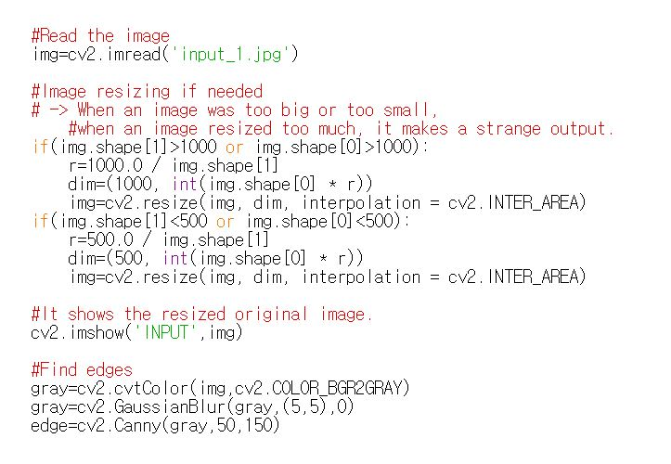
Step 1
Edge Detection

Slide 5
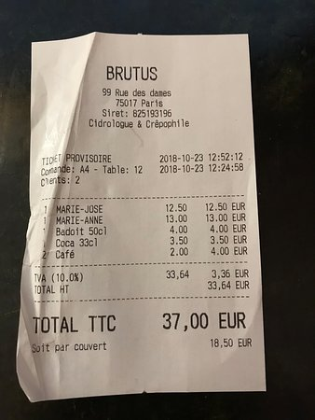
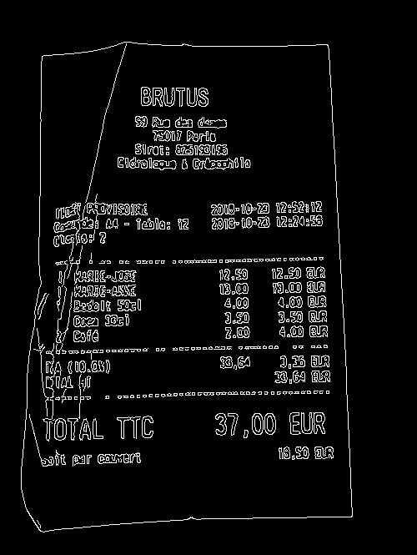
Step 1
Edge Detection

Slide 6
Step 2
Selecting a region
Edges
Find contours
Find maximum area
Valid Region

Slide 7
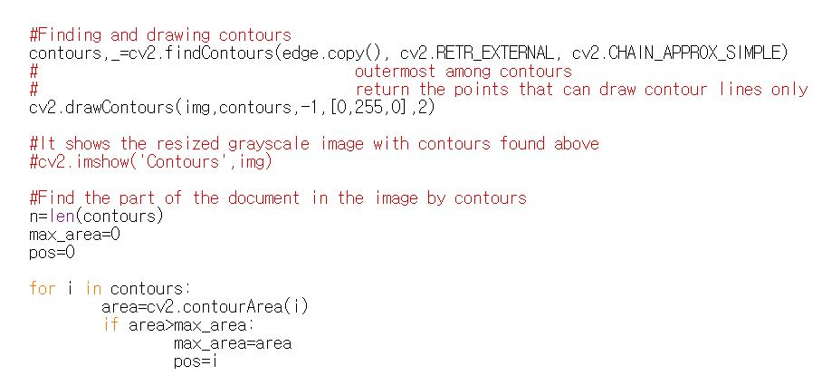
Step 2
Selecting a region

Slide 8
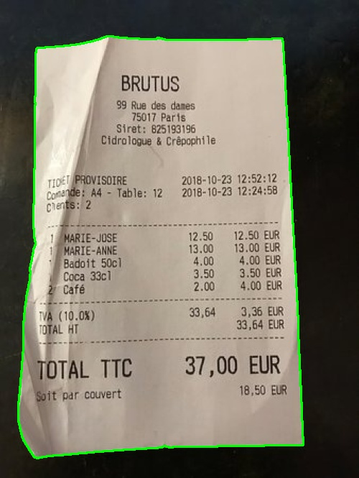
Step 2
Selecting a region

Slide 9
Step 3
Adjusting : using transpose matrix
Find vertex points
Valid region
Vertex points
Calculate transpose matrix
Output Size
Transpose matrix

Slide 10
Step 3
Adjusting : using transpose matrix
RGB to Gray
Transpose Matrix
Input Image
Matched Image

Slide 11
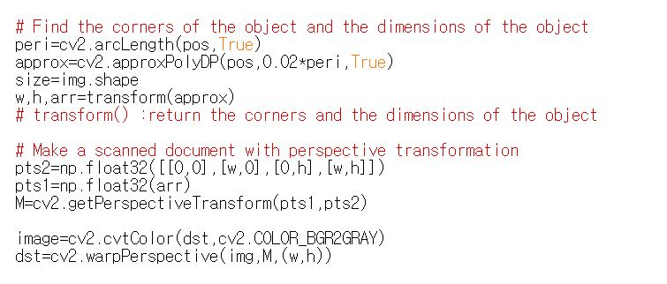
Step 3
Adjusting: using transpose matrix

Slide 12
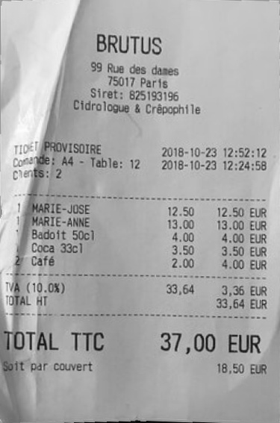
Step 3
Adjusting : using transpose matrix

Slide 13
Step 4
Revision : sharpening
Matched Image
Unsharp Masking
resize
Output Image
→ grayscale output

Slide 14
Step 4
Revision : thresholding and softening
Matched Image
Adaptive thresholding
Gaussian Blur
resize
Output Image
→ binary output

Slide 15
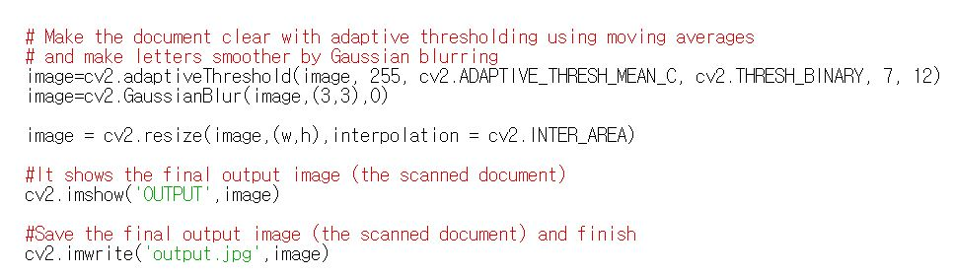
Step 4
Revision : thresholding and softening

Slide 16
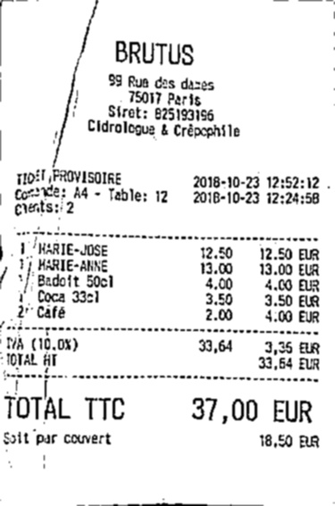
Step 4
Revision : thresholding and softening

Slide 17
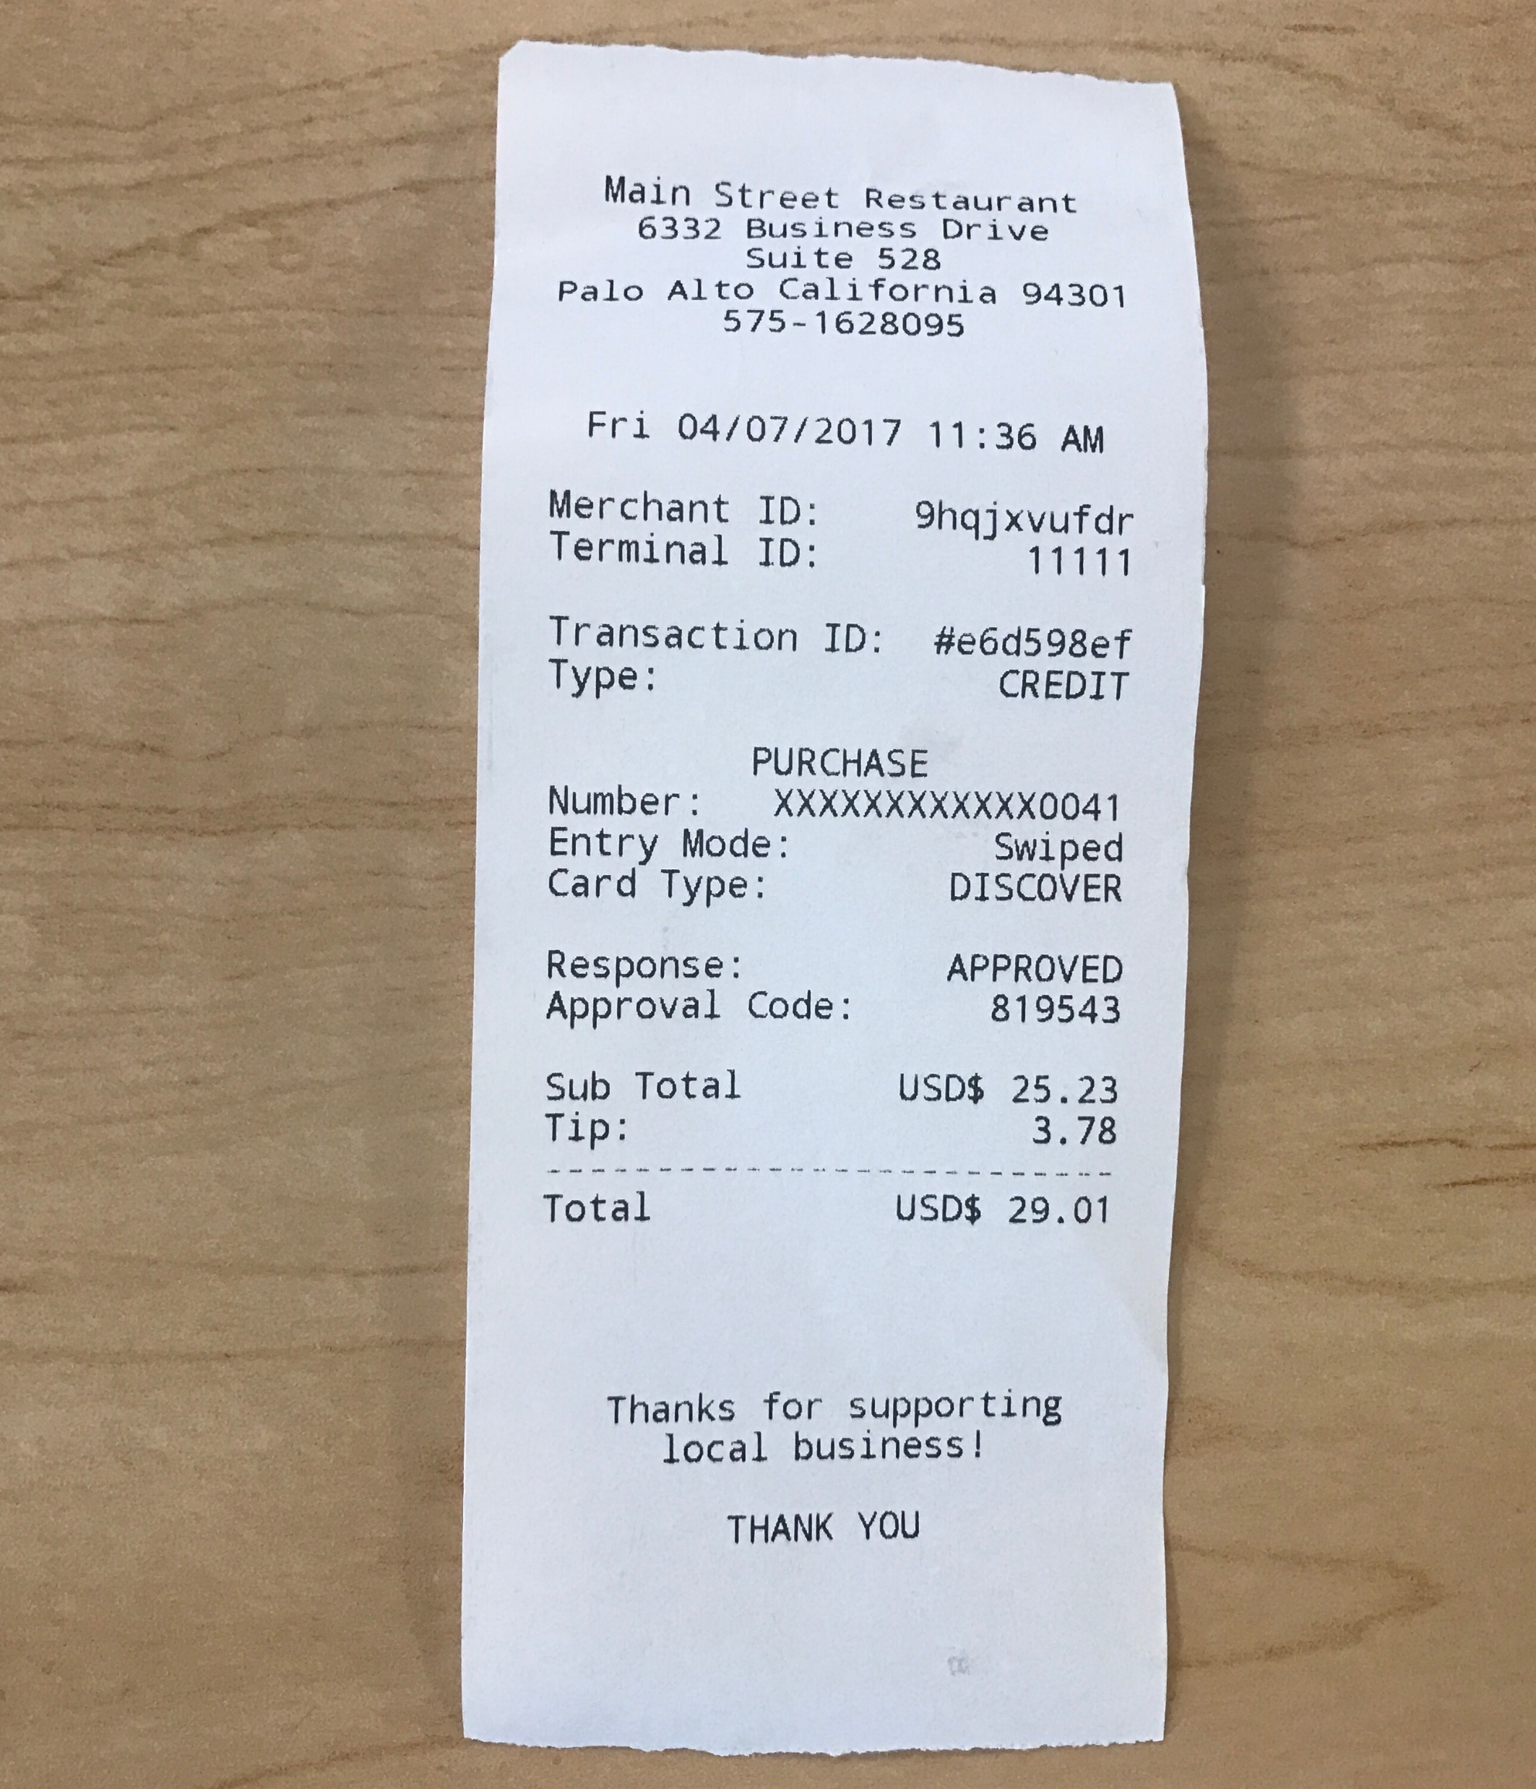
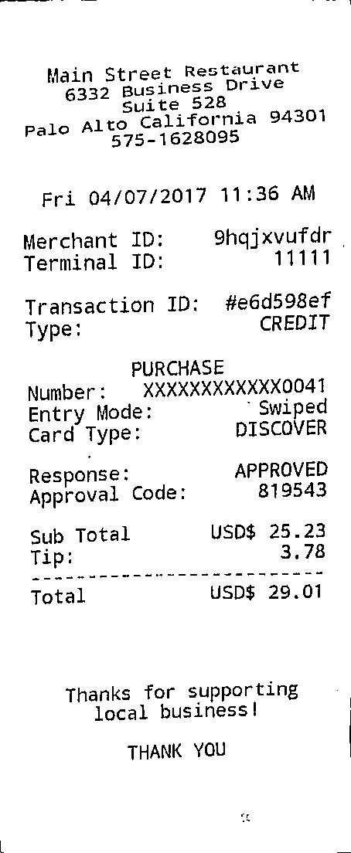
Results

Slide 18
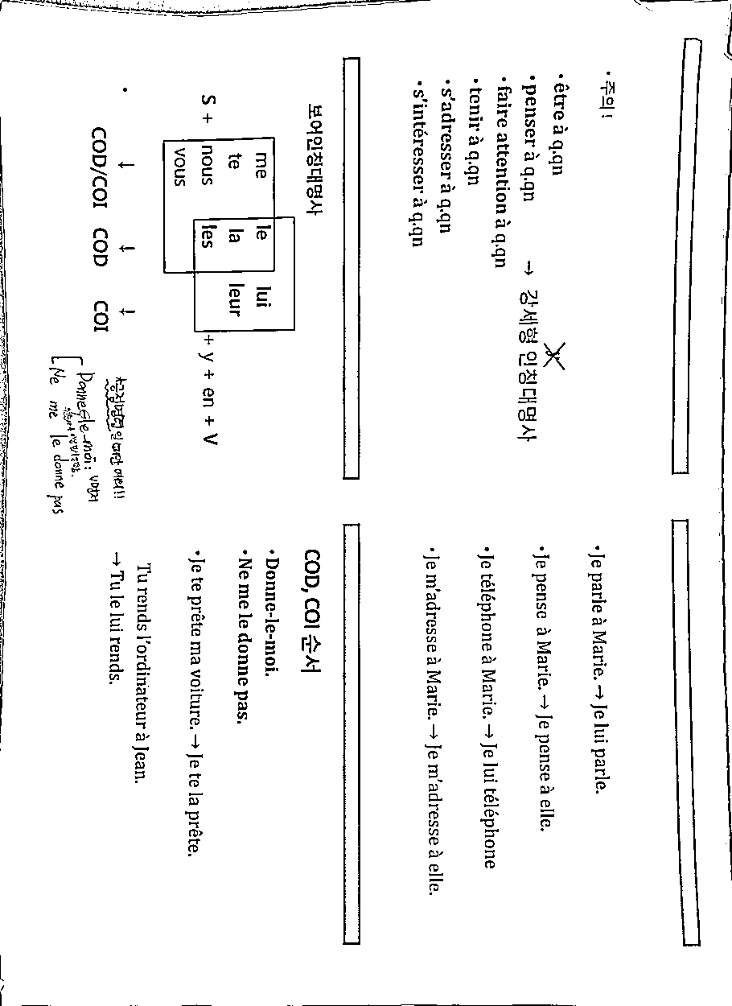
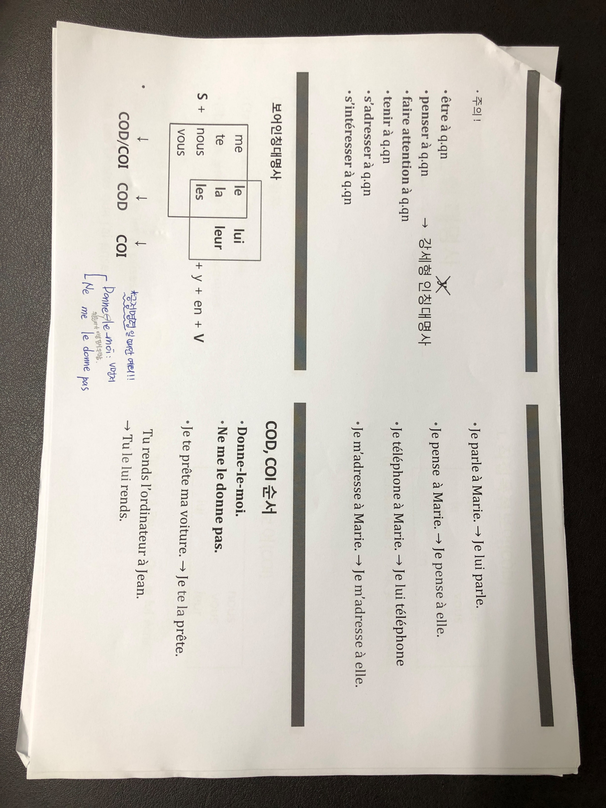
Results

Slide 19


Results

Slide 20
Thank You

Slide 21
Input image
cvtColor()
GaussianBlur()
Canny()
findContours()
Grayscale image
Blurred image
Set of edges
Set of contours
Find maximum area
Size of document
warpPerspective()
Transpose matrix
getPerspectiveTransform()
Find vertex points
Document area contour
Location of vertices
Fitted image
adaptiveThreshold()
GaussianBlur()
Unsharp masking
Binary output
Grayscale output

